Slide 1

Improving Relation Extraction
by
Pre-trained Language Representations
Deep Learning for Natural Language Processing
Navneet Singh Arora, Sushil Awale and Sana Moin
Dec 16, 2021
Notes:
Hello Everyone !
I am Navneet Singh Arora, along with my team-mates Sushil Awale and Sana Moin and we are here to present the topic of “Relation Extraction Improvement through Pre-trained Language Representations”.

Slide 2
Overview
Introduction
Problem / Motivation
Transformer Based Relation Extraction
Experiment Setup
Results
Analysis and Ablation Studies
Summary
Notes:
Before moving forward, we would like to give you the overview of this presentation.
Firstly, we will go through the basics of Relation Extraction and its importance.
We will set up the motivation, go through the Transformer architecture, explain the experimentation setup and finally conclude with the Analysis and the Summarization.

Slide 3
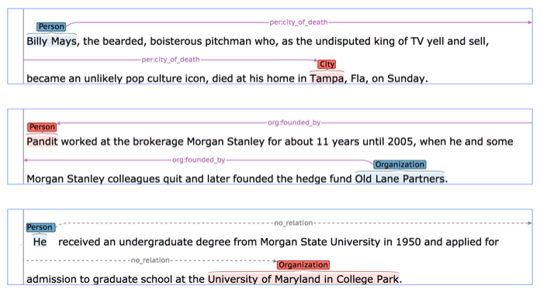
Introduction
Structured Information from Unstructured data.
Entity Linking
Probabilistic Inference
Extract Semantic Relations
Detection
Classification
[3] Zhang, Yuhao, et al.
Notes:
So, “What is Relation Extraction” ?
Well we have a lot of data available to us. But all this data is in an unstructured form.
Therefore, it is hard to get what we need directly from this data.
In-order to get some sense, Entity Linking and Probabilistic Inference are done, to form some kind of structure to the data.
And this is then used to extract the semantic relations present in a text using ‘Detection’ and ‘Classification’
As can be seen in the example here, the data is contains multiple entities like ‘Pandit’ and ‘Old Lane Partners’ in the second sentence, and the task is to infer the relation between these entities, which here is of a ‘founder’.
This is what is called Relation Extraction.

Slide 4


Importance of Relation Extraction
Solution: Relation Extraction
Available data is:
Vast
Heterogeneous
Ambiguous
Human Annotation
Expensive
Impossible (entire available data)
https://abbyy.technology/en:features:classification
Notes:
As we know the natural data available to us is
Vast
Heterogeneous as well as
Ambiguous
And annotating this amount of data is not only expensive but also impossible.
This is where, Relation Extraction provides a good solution to create meaningful structure data.

Slide 5

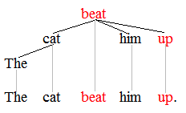
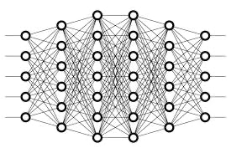
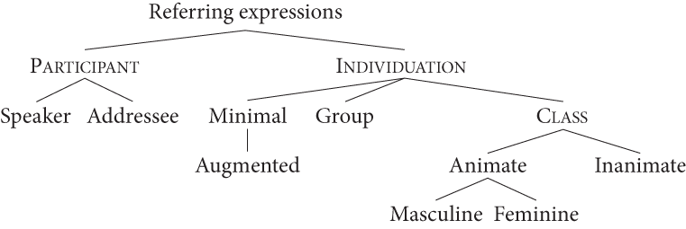
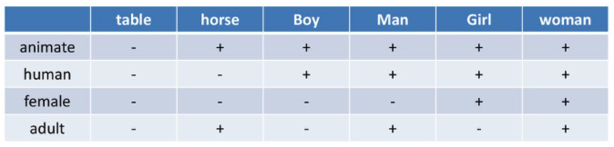
Motivation
Lexical Features
Relation Extraction
Model
Syntactic Features
Pre-processed
Input
Semantic Features
Notes:
Coming to the motivation behind this topic, current state-of-the-art relation extraction methods explicitly compute multiple features like:
Lexical Features -> which are finding the word classes,forming sub-words and so on
Syntactic Features -> determining the type of the word or text.
And finally,
Semantic Features -> Creating a language specific word context.
But this all involves the pre-processing which is then fed to the Relation Extraction Model. This is not only expensive but also error prone.
Apart from this, these features are are not explicitly available in Non-English Languages.
Therefore, the authors try to get rid of this and instead introduce transformers.
Oops, not these transformers. Let us take a look at the real transformers.

Slide 6
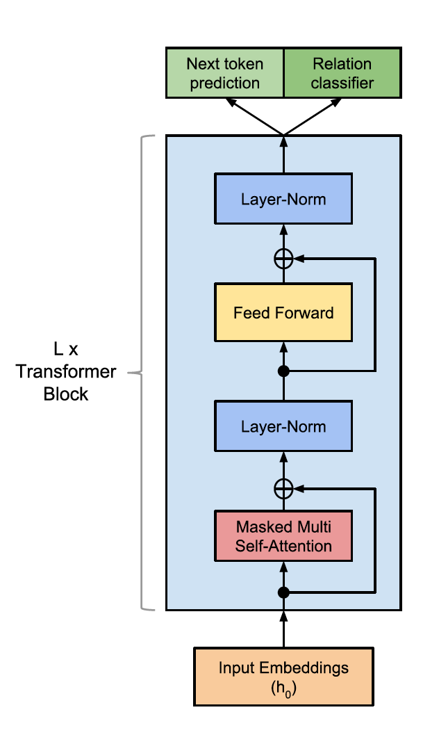
Model Architecture - TRE
Transformer Based decoder-only variant
Repeated layer encoding - Transformer Blocks
Self Attention
Token Indices Sequence – T
Word-Embedding Matrix – W_{e}
Word-Position Embedding Matrix – W_{p}
[5] Alt, Christoph, Marc Hübner, and Leonhard Hennig
Notes:
Here, we take a look at TRE: Transformer based Relation Extraction Model Architecture.
So this model is a decoder only variant of the Transformer: Encoder Decoder Model.
Multiple such Transformer blocks similar to the one shown in this figure are used to repeatedly encode the inputs and finally use them for classification.
On top of that Self-Attention masking is used which ensures no look-ahead is done for any input.
Considering the input being passed on to the model, it consists of Token Indices, Word-embedding Matrix and Word-Position Embedding Matrix.
Let us take a deeper look into how they are being used.

Slide 7
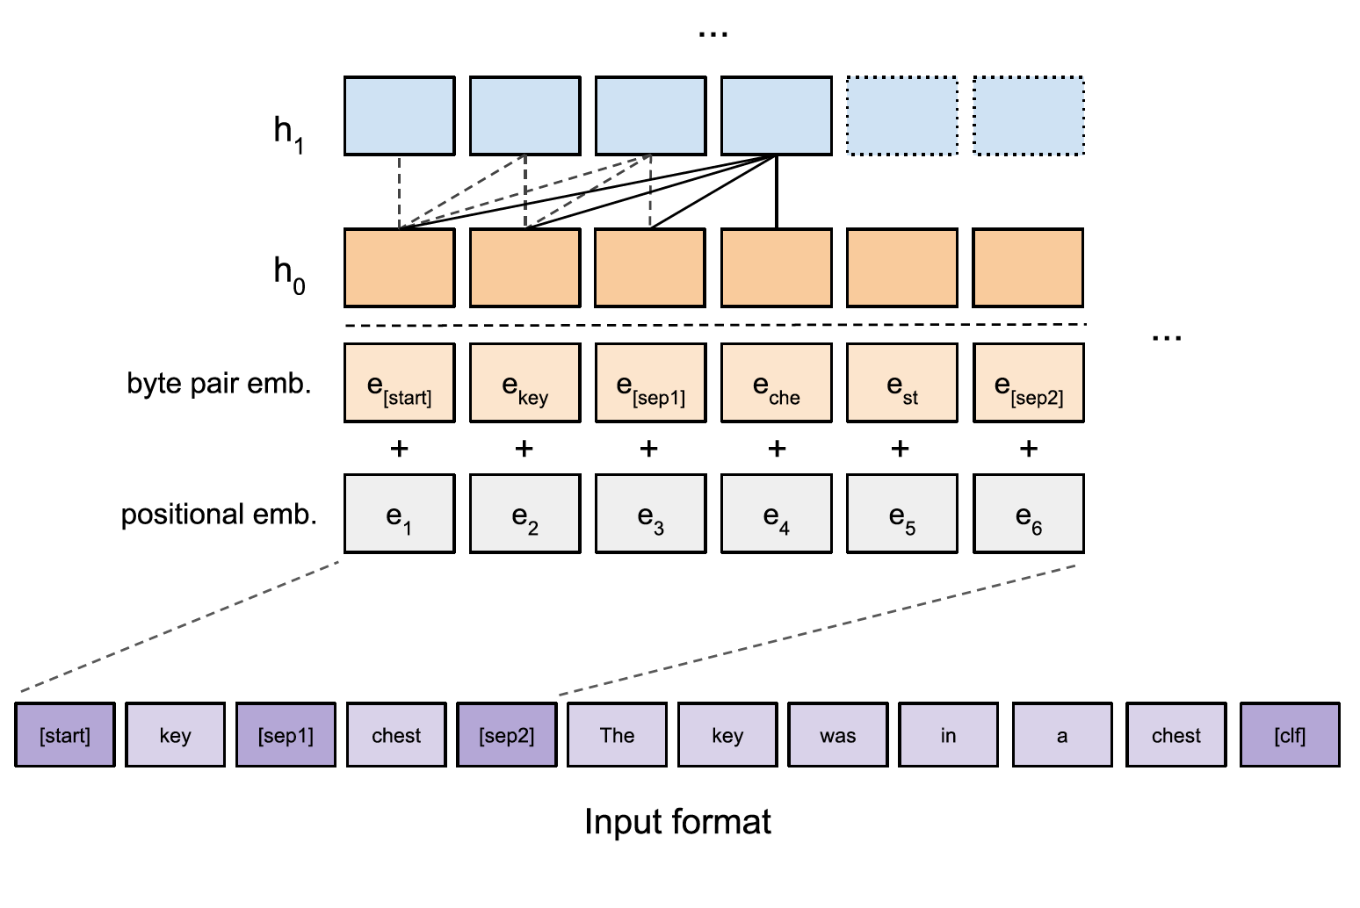
Model Architecture - TRE
Input Representation
Special Tokens
Start
Entities
End
Byte-Pair Encoding
Entity-Relation Information
[5] Alt, Christoph, Marc Hübner, and Leonhard Hennig
Notes:
This here represents the overall Input Representation, which includes the Input Token Sequence with special tokens for Start, End and Multiple Entity Token Separators.
These tokens are then encoded using BPE: Byte Pair Encoding technique which is one of the many tokenization techniques used to create the embeddings. These are then merged with the positional embeddings forming the final token embedding.
Along with this entire input structure, the input also consists of the delimiter separated entity information in the beginning of the token sequence and relation information in the end of the token sequence, to avoid a lot of architectural changes.

Slide 8
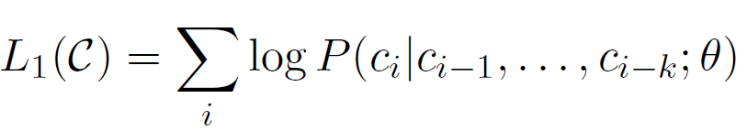
Unsupervised Pre-training of Language Representations
Unsupervised lexical, syntactic, and semantic features extraction
Language model to maximize likelihood:
BooksCorpus used:
800M words of different genres
L = 12 layers (blocks) with 12 attention heads
Existing byte pair encoding vocabulary: 40,000 tokens

Slide 9
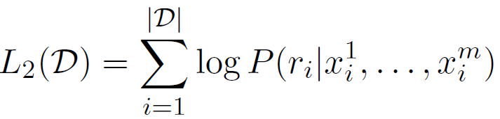
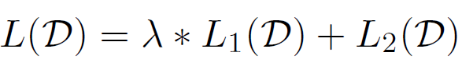
Supervised Fine-tuning on Relation Extraction
Fine tune on relation extraction task over pre-trained language model
Overall objective:
Improves generalization
Faster convergence

Slide 10
Datasets
TACRED
Sentences with entity mention pairs from TAC BKP evaluations from 2009-2014
Training: years 2009 to 2012, Evaluation: 2013, Testing: 2014
Typed entity mentions, Subjects: person and organization, Objects: 16 fine-grained classes
SemEval 2010 Task 8
Binary relation classification
Training: 8000, Testing: 2717
Untyped nominals, 19 distinct types
Dataset | Relation Types | Examples | Negative examples
TACRED | 42 | 106,264 | 79.5%
SemEval | 19 | 10,717 | 17.4%

Slide 11
Entity Masking
4 strategies:
UNK: All tokens with UNK
NE: each entity mention with its named entity type
GR: substitute a mention with its grammatical role
NE + GR: combination of above 2
Prevents overfitting, better generalization to unseen entities

Slide 12
Hyperparameter Settings and Optimization
Adam optimization scheme
Batch size: 8,
Linear learning rate decay schedule with warm-up over 0.2% of training updates
Classier dropout : 0.1 rate
 | Epochs | Learning Rate | Warmup learning rate | lambda | Attn. Dropout
TACRED | 3 | 5.25e-5 | 2e-3 | 0.5 | 0.1
SemEval | 3 | 6.25e-5 | 1e-3 | 0.7 | 0.15

Slide 13
Results: TACRED
Table I: TACRED single-model test set performance using NE + GR entity masking strategy across 5 randomly initialized runs
System | Precision | Recall | F1 Score
LR (Zhang et al. [2017]) | 72.0 | 47.8 | 57.5
CNN (Zhang et al. [2017]) | 72.1 | 50.3 | 59.2
Tree-LSTM (Zhang et al. [2018]) | 66.0 | 59.2 | 62.4
PA-LSTM (Zhang et al. [2018]) | 65.7 | 64.5 | 65.1
C-GCN (Zhang et al. [2018]) | 69.9 | 63.3 | 66.4
TRE | 70.1 | 65.0 | 67.4

Slide 14
Results: SemEval
Table II: SemEval single-model test set performance across 5 randomly initialized runs
System | Precision | Recall | F1 Score
SVM (Rink and Harabagiu [2010]) | - | - | 82.2
PA-LSTM (Zhang et al. [2018]) | - | - | 82.7
C-GCN (Zhang et al. [2018]) | - | - | 84.8
DRNN (Xu et al. [2016]) | - | - | 86.1
BRCNN (Cai et al. [2016]) | - | - | 86.3
PCNN (Zeng et al. [2015]) | 86.7 | 86.7 | 86.6
TRE | 88.0 | 86.2 | 87.1

Slide 15
Results: using UNK tokens
Model generalizes beyond entity mentions
Table III: SemEval single-model test set performance with all entity mentions masked by an UNK token across 5 randomly initialized runs
System | Precision | Recall | F1 Score
PA-LSTM (Zhang et al. [2018]) | - | - | 75.3
C-GCN (Zhang et al. [2018]) | - | - | 76.5
TRE | 80.3 | 78.2 | 79.1

Slide 16
Analysis and Ablation Studies: Effect of Pre-Training
Pre-training has a regularizing effect
Pre-training captures features informative as providing entity type and grammatical role info
Table IV: Ablation (F1 scores) with and without masked entities for validation set across 5 randomly initialized runs
 | SemEval |  | TACRED
 | None | UNK | None | UNK | NE + GR
Best Model | 85.6 | 76.9 | 63.3 | 51.0 | 68.0
w/o pre-trained LM | 75.6 | 68.2 | 43.3 | 41.6 | 64.2
w/o pre-trained LM and BPE | 55.3 | 60.9 | 38.5 | 38.4 | 60.8

Slide 17
Analysis and Ablation Studies: Effect of Entity Masking
Semantic role type is a helpful feature
or it provides robust information on position of argument entity in input sentence
Table V: TACRED validation F1 scores with different entity masking strategies
System | Precision | Recall | F1 Score
None | 69.5 | 58.1 | 63.3
UNK | 56.9 | 46.3 | 51.0
GR | 63.8 | 50.1 | 56.1
NE | 68.8 | 65.3 | 67.0
NE + GR | 68.8 | 67.2 | 68.0

Slide 18
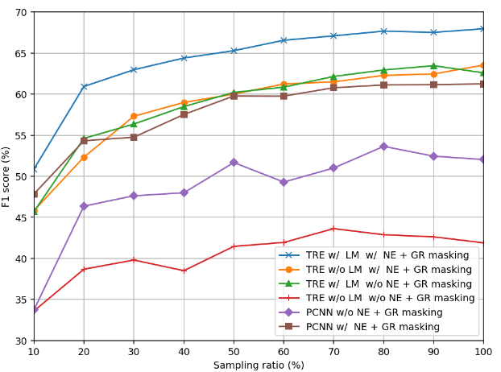
Analysis and Ablation Studies: Sample Efficiency
Stratified subsampling
Splits TACRED training set with sampling ratios from 10% to 100%
TRE model with NE+GR masking
achieves F1 score higher than 60 with 20% training data
Figure: Micro-averaged F1 score on the validation set over increasing sampling ratios of training set

Slide 19
Summary
Use of explicit features makes it difficult to adapt models to novel languages
Transformer based relation extraction
replaces use of explicit features with implicit features captured in pre-training language representations
drastically improves sample efficiency

Slide 20
Reference
Alt, C., Hübner, M., & Hennig, L. (2019). Improving relation extraction by pre-trained language representations. arXiv preprint arXiv:1906.03088.

Slide 21
Thank you!
Any Questions?

